Slide 1

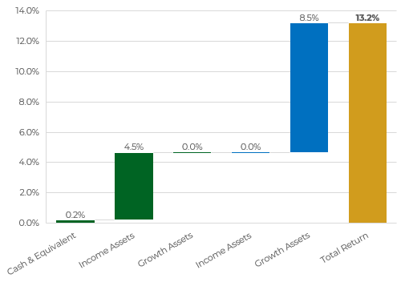
Portfolio Summary
Expected Return : 13.2% | Expected Volatility : 11.7%
Liquidity Profile
Income Generation : 4.7%
Allocation% : 50% Exp. Vol : 5.3%
Growth : 8.5%
Allocation% : 50% Exp. Vol : 18.1%
Publics / Privates Composition
INFORMATIONAL PURPOSES ONLY: The materials and information in this slide have been prepared or assembled by the Firm and are intended for informational purposes only. Some of the information may be dated and may not reflect the most current market developments.

Slide 2
Confidential
Overview on Asset Allocation – Income vs Growth
Type Sub-Asset Class | Allocation (%) | Allocation ($)
Growth (Liquid) Public Equities | 15% | 1,500,000
Growth (Semi) Public Equities, Hedge Funds Private Equity | 35% | 3,500,000
Growth (Illiquid) Private Equity, Hedge Funds Commodities | 0% | 0
Income (Liquid) Public Fixed Income | 15% | 1,500,000
Income (Semi) Private Credit | 30% | 3,000,000
Income (Illiquid) Private Credit Real Estate | 0% | 0
Cash & Equivalent Money Market Funds | 5% | 500,000
Total | 100% | 10,000,000
INFORMATIONAL PURPOSES ONLY: The materials and information in this slide have been prepared or assembled by the Firm and are intended for informational purposes only. Some of the information may be dated and may not reflect the most current market developments.

Slide 3
Confidential
Proposed Portfolio
Liquidity | Name | Allocation ($) | Allocation (%) | Expected Income (%) | Expected Income ($) | Expected Returns (%) | Expected Returns ($) | Hypothetical Volatility
 | Cash & Equivalent | $500,000 | 5.0% |  |  | 4.2%
Liquid | Cash (Money-Market Fund) | $500,000 | 5.0% | 4.2% | $21,000 | 4.2% | $21,000 | 0.0%
 | Public Fixed Income | $1,500,000 | 15.0% |  |  | 6.0%
Liquid | Fixed Income Funds (Artisan / Bramshill / Osterweis) | $1,500,000 | 15.0% | 6.0% | $90,000 | 6.0% | $90,000 | 8.0%
 | Private Credit | $3,000,000 | 30.0% |  |  | 11.8%
Semi-Liquid | Private Credit: Asset Backed (Origin / Regan) | $1,000,000 | 10.0% | 11.5% | $115,000 | 11.5% | $115,000 | 4.8%
Semi-Liquid | Private Credit: Direct Lending (Monroe / ASP / Callodine) | $2,000,000 | 20.0% | 12.0% | $240,000 | 12.0% | $240,000 | 4.8%
 | Public Equity | $2,000,000 | 20.0% |  |  | 14.5%
Semi-Liquid | US SMID Cap (Ancora Bellator Fund) | $500,000 | 5.0% |  |  | 12.0% | $60,000 | 23.6%
Liquid | Global Equities (Katam Hill) | $1,000,000 | 10.0% |  |  | 18.0% | $180,000 | 20.0%
Liquid | US Tech (Glynn) | $500,000 | 5.0% |  |  | 17.0% | $85,000 | 19.8%
 | Private Equity | $1,000,000 | 10.0% |  |  | 17.5%
Semi-Liquid | Private Equity: Open-ended (Harbourvest) | $1,000,000 | 10.0% |  |  | 17.5% | $175,000 | 16.6%
 | Hedge Funds | $1,500,000 | 15.0% |  |  | 18.3%
Semi-Liquid | Equity L/S Low Vol (NIM) | $1,000,000 | 10.0% |  |  | 15.0% | $150,000 | 10.0%
Semi-Liquid | Equity L/S TR (Katam Hill) | $500,000 | 5.0% |  |  | 25.0% | $125,000 | 30.0%
 | Commodities | $500,000 | 5.0% |  |  | 15.5%
Semi-Liquid | Broad Commodities Manager (Quantix) | $500,000 | 5.0% |  |  | 15.5% | $77,500 | 14.8%
 | Total Portfolio | $10,000,000 | 100.0% | 4.7% | $466,000 | 13.2% | $1,283,500 | 11.7%
INFORMATIONAL PURPOSES ONLY: The materials and information in this slide have been prepared or assembled by the Firm and are intended for informational purposes only. Some of the information may be dated and may not reflect the most current market developments.

Slide 4
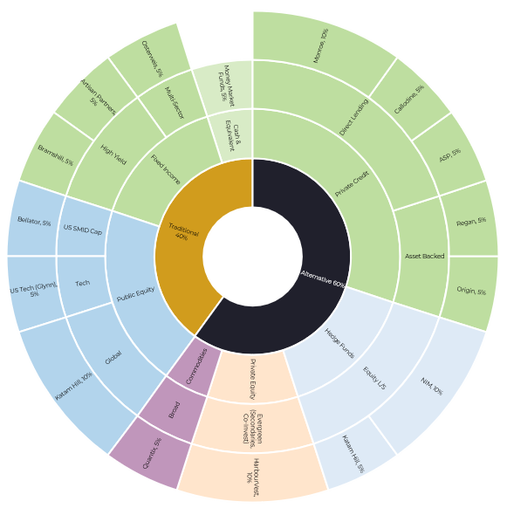
Confidential
Overview on Asset Allocation – Traditional vs Alternative
Classification | Asset Class | Sub-Asset Class | Instrument | Allocation (%)
Traditional |  |  |  | 40%
 | Cash & Cash Equiv. |  |  | 5%
 |  |  | MMF | 5%
 | Public Fixed Income |  |  | 15%
 |  | High Yield | Artisan / Bramshill | 10%
 |  | Multi-Sector | Osterweis | 5%
 | Public Equity |  |  | 20%
 |  | US SMID Cap | Bellator | 5%
 |  | Global | Katam Hill | 10%
 |  | Tech | Glynn | 5%
Alternative |  |  |  | 60%
 | Private Credit |  |  | 30%
 |  | Asset Backed | Origin / Regan | 10%
 |  | Direct Lending | Monroe / HPS / Callodine / Tree Line | 20%
 | Private Equity |  |  | 10%
 |  | Evergreen | HarbourVest | 10%
 | Hedge Funds |  |  | 15%
 |  | Equity L/S (Low Vol) | NIM | 10%
 |  | Equity L/S (TR) | Katam Hill | 5%
 | Commodities |  |  | 5%
 |  | Broad | Quantix | 5%
Total |  |  |  | 100.0%
INFORMATIONAL PURPOSES ONLY: The materials and information in this slide have been prepared or assembled by the Firm and are intended for informational purposes only. Some of the information may be dated and may not reflect the most current market developments.

